Slide 1
Power BI Architecture
High-Level Architecture Overview for ElectroHub

Slide 2
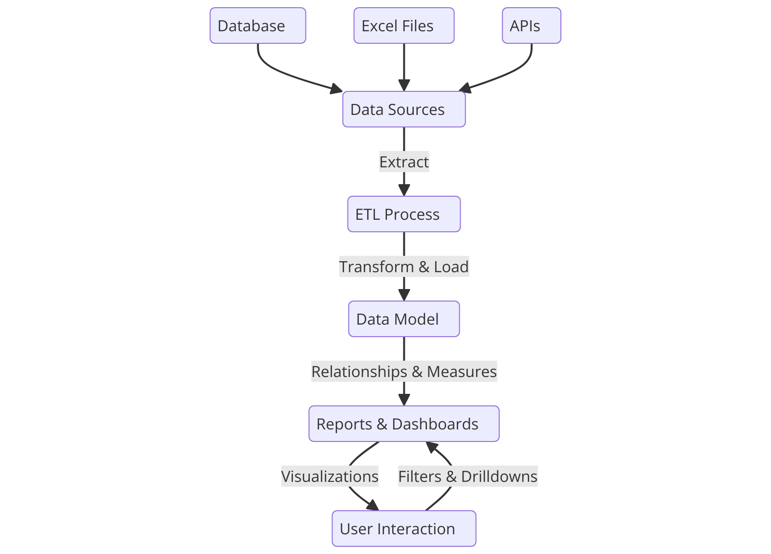
Architecture Diagram

Slide 3
Data Flow in Power BI
- Extract data from SQL & CSV sources
- Transform data using Power Query
- Load into Power BI data model
- Apply DAX calculations & measures
- Visualize using dashboards & reports

Slide 4
Security & Access Control
- Role-Based Access Control (RBAC)
- Row-Level Security (RLS)
- Data encryption and restricted access
- Authentication via organizational credentials

Slide 5
Performance Optimization
- Use of aggregations for faster queries
- Incremental data refresh strategy
- Optimized DAX calculations
- Data compression techniques

